Slide 1
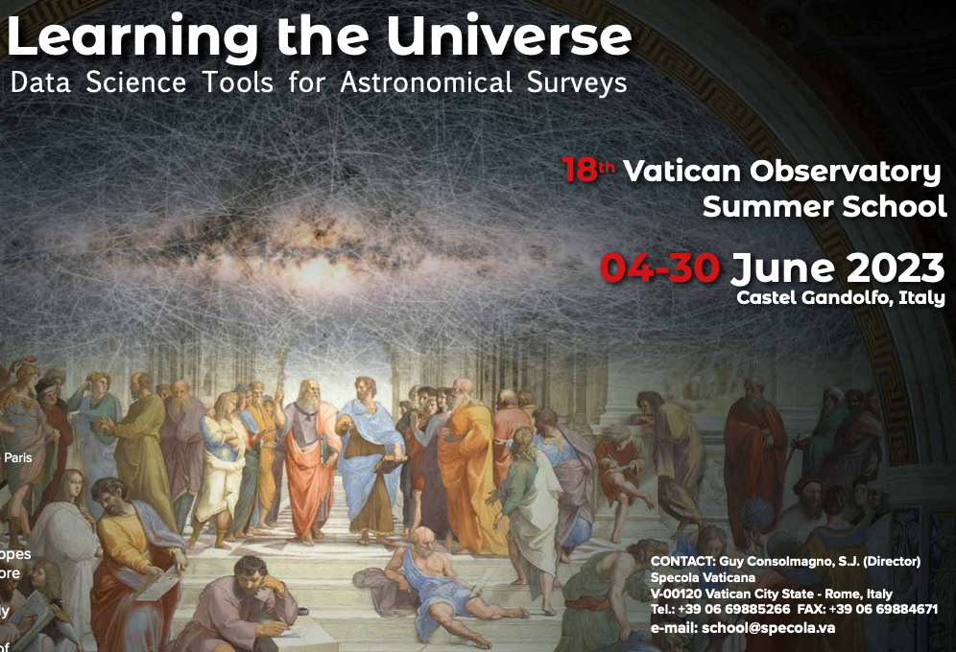
VOSS 2023: Introductory Lecture
Viviana Acquaviva
&
Željko Ivezić

Slide 2
Outline
1) Introductions (following the School Booklet)
- 1 min per person, quick background, interests, tell us one thing that
makes you excited to be here today
2) Code of Conduct
- we all come from different backgrounds and thus we need to set common
expectations to make the School a pleasant experience for everyone.
3) Lecture plan, GitHub, additional activities
- what the School will cover, how days are organized, where you will
get lectures and other materials
4) Discussion and Questions
Notes:
I say we start the icebreaker by telling them something, then students

Slide 3
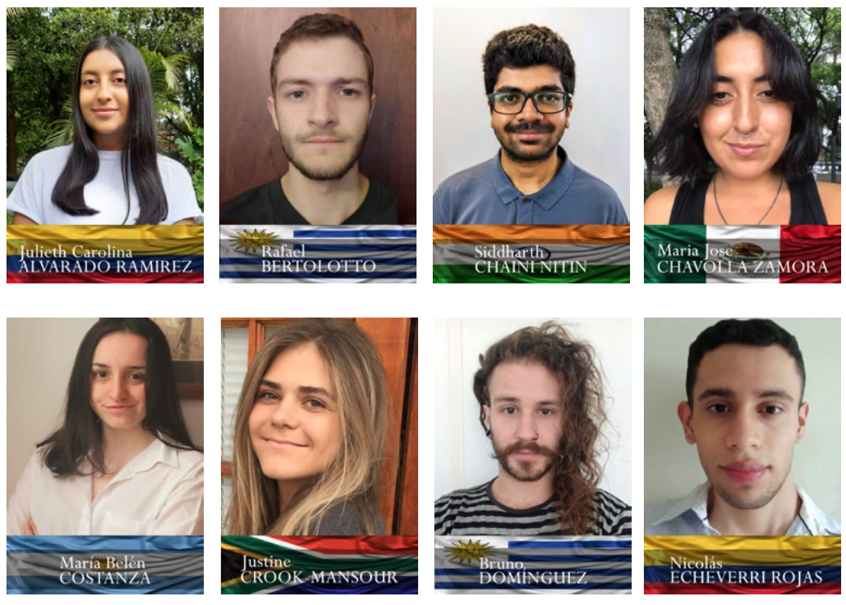
Introductions

Slide 4
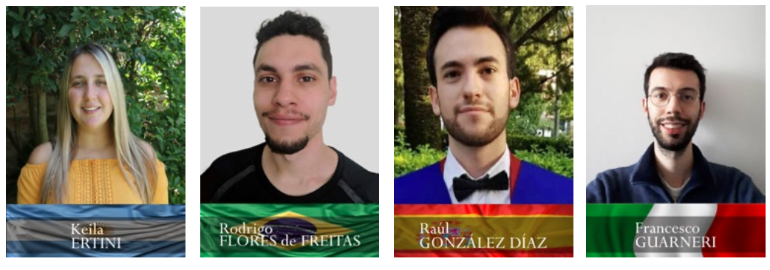
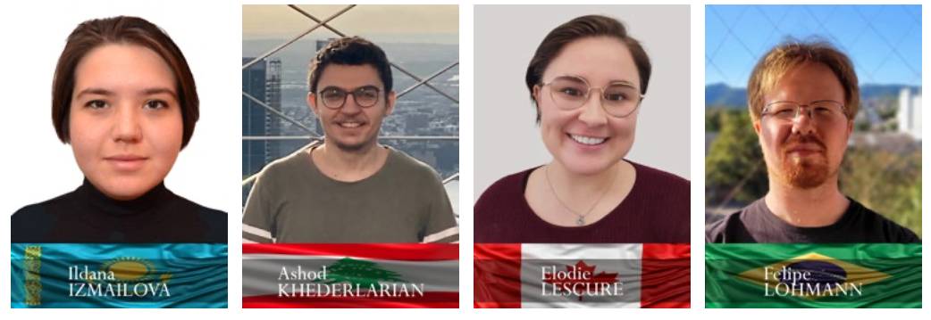
Introductions

Slide 5
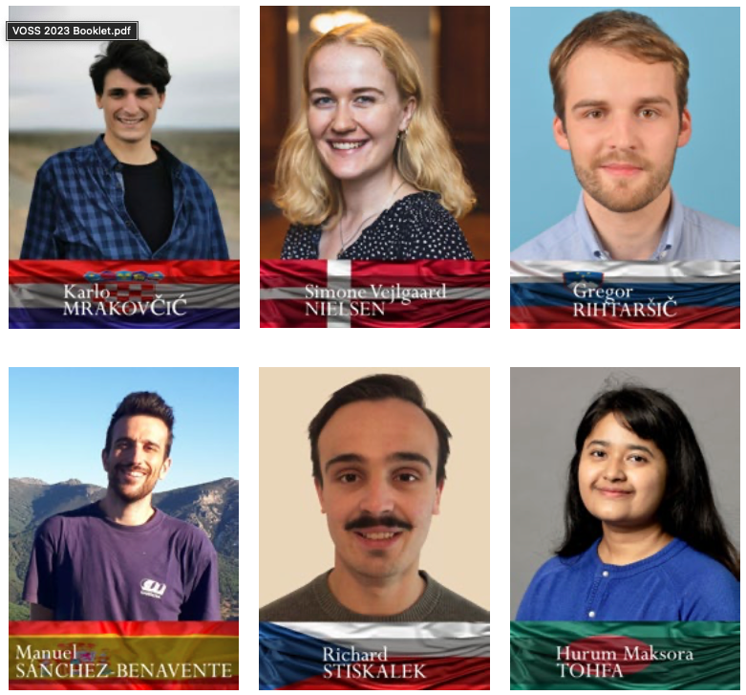

Slide 6
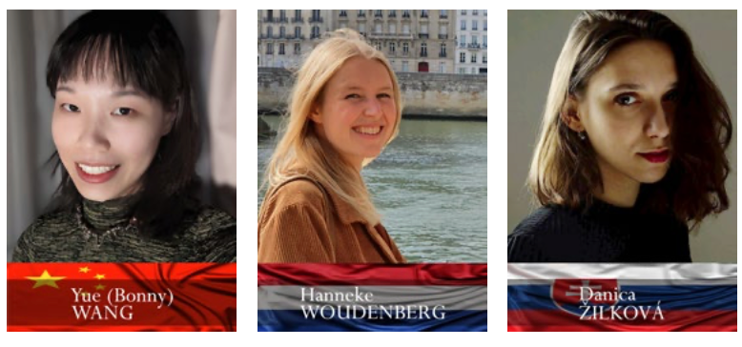

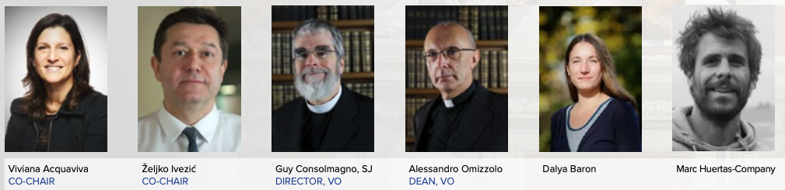
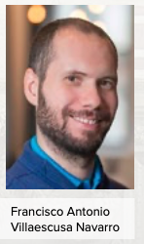

Slide 7
Code of Conduct
The Vatican Observatory Summer School aims to be a welcoming environment to all.
We are committed to creating an inclusive, collaborative environment, which welcomes passionate and thoughtful discussion and interaction and respects everyone’s cultural and other backgrounds.
The code of conduct applies to every interaction, verbal and written, while here at the school.
Notes:
We should tell them what to do if they feel there was a breach – come to one of us?

Slide 8
Code of Conduct
The Vatican Observatory Summer School aims to be a welcoming environment to all.
We are committed to creating an inclusive, collaborative environment, which welcomes passionate and thoughtful discussion and interaction and respects everyone’s cultural and other backgrounds.
The code of conduct applies to every interaction, verbal and written, while here at the school.
We will adhere to the following principles in order to provide a learning environment that produces rigor and excellence (developed by Federica Bianco and Lucianne Walkowicz for Rubin Observatory) :

Slide 9
Code of Conduct
Be Kind Acting with and encouraging kindness strengthens individuals, relationships, and communities.
Trust An inclusive, collaborative environment is best achieved when there is mutual trust, based upon honest behavior, throughout the community.
Respect Inclusive environments foster excellence by challenging us to consider a variety of viewpoints and approaches. We honor alternate viewpoints as opportunities for discussion and learning, and therefore treat others with respect, even if we disagree.

Slide 10
Code of Conduct
Inclusiveness We recognize the importance of actively including and encouraging involvement from all corners; diversity is only a benefit if all members feel empowered to participate. Quoting from the American Astronomical Society guidelines: "Scientists should work to provide an environment that encourages the free expression and exchange of scientific ideas.
They should promote equality of opportunity and fair treatment for all their colleagues, regardless of gender, race, ethnic and national origin, religion, age, marital status, sexual orientation, gender identity and expression, disability, veteran status, etc.
“Scientific ability must be respected wherever it is found."

Slide 11
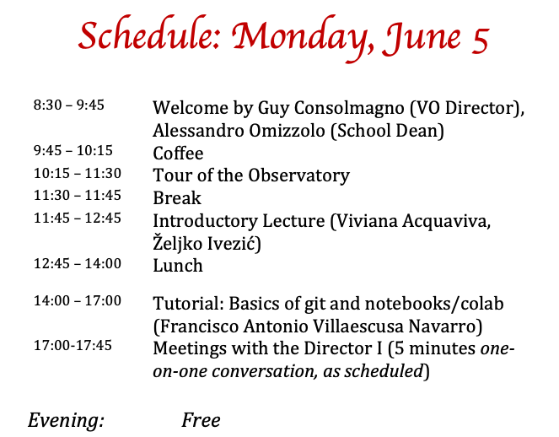
We will have daily updates with lectures and other events:
Most of our daily communications will happen through Slack.
Make sure you accept the invitation sent by Antonio!

Slide 12
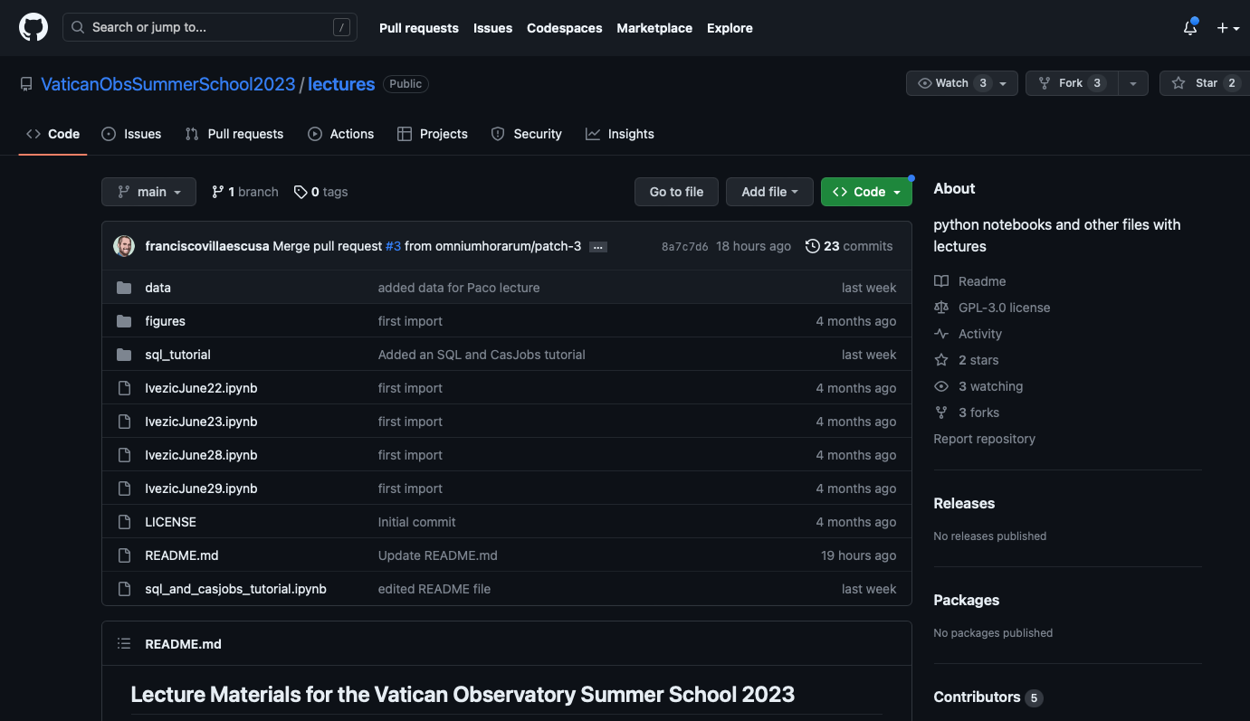
Lecture Plan: where are the lectures?
https://github.com/VaticanObsSummerSchool2023/lectures
ALL YOU NEED TO WRITE DOWN IS THIS LINK: https://ls.st/s23
which will take you to the long link above.
Then you can clone the repository as described
there and you’ll have all lectures, including these
slides, on your laptop.

Slide 13
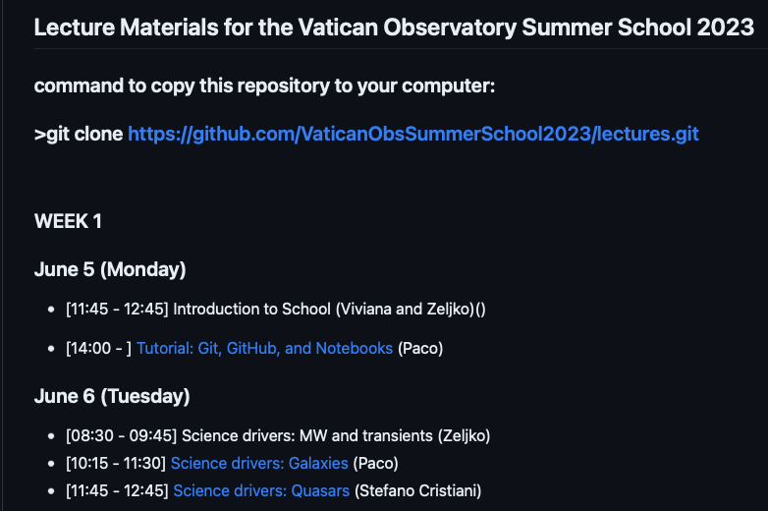
Lecture Plan
Note:
Not all lectures
are available
or in their final form
at this time ☺
git pull
is how you refresh your
copy of the repository
to see new materials.
More in this afternoon’s tutorial!

Slide 14
Lecture Plan
The School is organized around four main themes:
1) Science drivers for obtaining large astronomical datasets;
2) Publicly available tools for accessing images, catalogs, and other datasets;
3) Statistical methods for interpreting measurements;
4) Modern data mining and machine learning methods and tools.
You will hear about these from us, in a combination of lectures, tutorials, and programming exercises.
Additionally, starting from Week 2 you will pick a project to work on with a team; we’ll introduce the projects later this week.

Slide 15
Lecture Plan
Usually, the daily schedule looks like this:
8:30 to 9:45 Lecture 1
9:45 to 10:15 Coffee
10:15 to 11:30 Lecture 2
11:30 to 11:45 Break
11:45 to 12:45 Lecture or Guest Talk or Student Talk
12:45 to 14:00 Lunch
Afternoon: Tutorials (week 1) or Project activity (weeks 2-4)
19:00 to 20:00: Guest Talk (some times)
Notes:
Note: we need to schedule the student talks (ask them to volunteer for a slot!) When?

Slide 16
Guest lectures
The school is made extra special by our excellent guest lecturers. They will cover research themes related to Big Data in Astronomy or Data Science Tools.
Our guest lecturers are:
Stefano Cristiani Giorgio Calderone
Adam Hincks Enrique Solano Marquez
Maria Elena Monzani Richard D’Souza
Vernesa Smolčić Andrea Grazian
Dovi Poznanski Christopher Corbally
Gabriele Gionti Robert Macke

Slide 17
Additional (and amazing) activities
Besides lectures, guest lectures, student talks, and project activities, we will also share some social activities and experiences. These include:
The weekend trip to Firenze (June 9-11)
The papal audience (June 15)
The visit to the gardens and domes of the observatory (June 20)
The trip to the beach (June 24)
and others. Stay tuned (via Slack) for updates!

Slide 18
From school to community
This is not a Summer school like any other. We get to spend a month together.
Something you learn with experience (the nice way of saying “with age”) is that what matters more than the journey are the people you share it with!
We hope that you will learn something useful for your future career at this school!
But most of all, we hope that you’ll find your people and start building or growing your community – those who you trust and will be your friends, peer mentors, and collaborators for many years to come.

Slide 19
A big thank you!
To everyone who has built momentum, supported us every step of the way, and allowed us to be here today, in particular:
Director Guy Consolmagno
Dean Alessandro Omizzolo
Stefano Cristiani
Andrea Grazian
Antonio Coretti
Matteo Galaverni
Federico Balzoni

Slide 20
Discussion and Questions
Before we start discussion, one more thing: in order to make our Tuesday afternoon activity more efficient,
you need to open two accounts to be able to access data from various surveys. When you get a chance later today (it takes up to 24 hours to get approval), please do the following:
1) Go to NOIRLab DataLab’s login page:
https://datalab.noirlab.edu/account/login.html
and open yourself an account (see the bottom left link “Create Account”).
2) Go to the IRSA portal:
https://irsa.ipac.caltech.edu/frontpage/
and click first on “Login” in the top right corner, and then “Create New Account” at the bottom.

